Slide 1
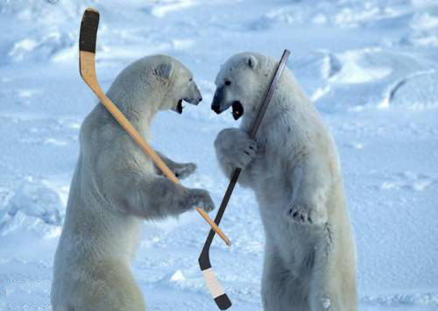
Beyond the Hockey Stick:
Paleoclimate Reconstructions of the Last 1000 years
by Steven Wickson

Slide 2
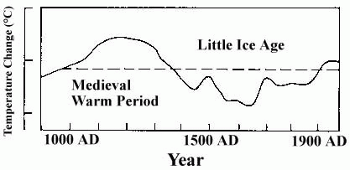
Temperature from 900AD-1990AD
from IPCC’s Second Assessment Report, 1995

Slide 3
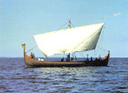
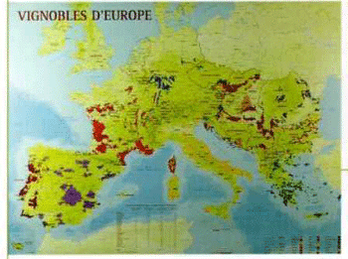
Medieval Warm Period (800AD-1300AD)
"Whan that Aprille with his shoures soote -
The droughte of March hath perced to the roote,
And bathed every veyne in swich licour
Of which vertu ungendred is the flour;"
- from The Canterbury Tales, by Geoffrey Chaucer, 1386

Slide 4
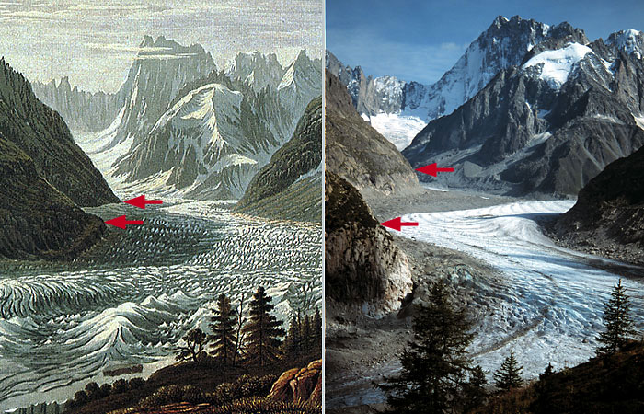
Little Ice Age (1300AD-1850AD)
The Mer de Glace viewed from Montenvers, Mont Blanc region, French Alps. The left-hand picture is an extract from a painting by Birman soon after the Little Ice Age maximum. The right-hand photograph was taken from a similar position in 2000.

Slide 5
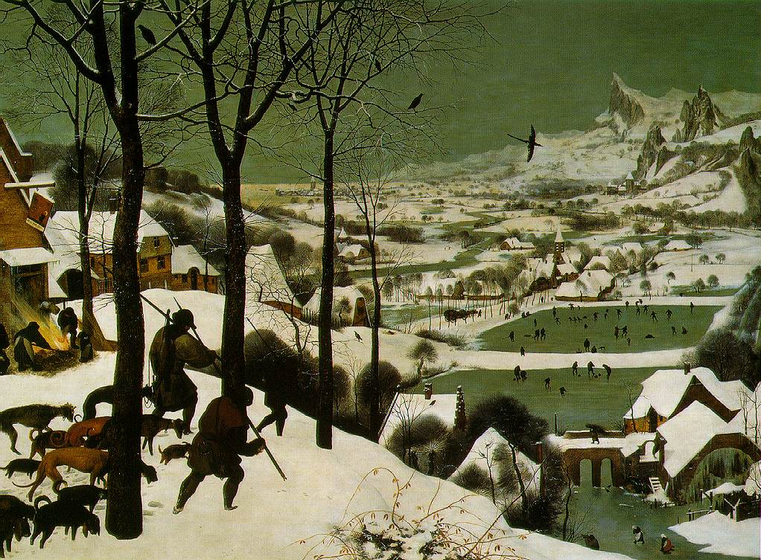

Slide 6
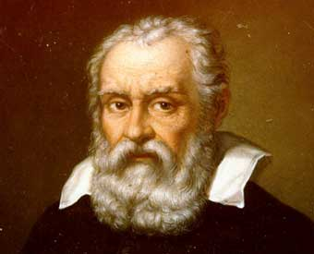
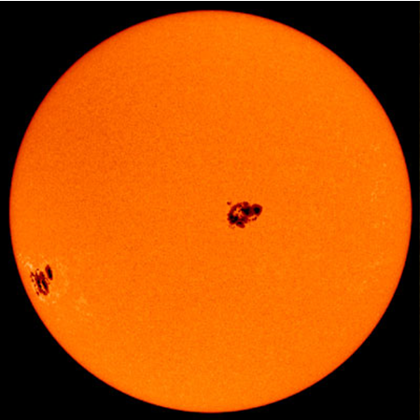
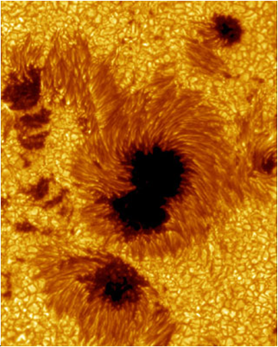
Sunspots

Slide 7
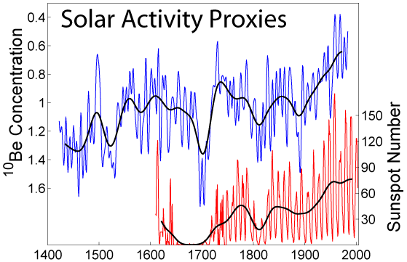
Sunspot data
(Hoyt & Schatten, 1998;
Beer et al. 1994) compared with Climate record from IPCC’s First Assessment Report

Slide 8
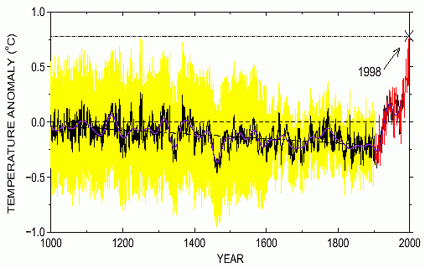
The Hockey Stick Graph (Mann, Bradley, Hughes, 1999)
IPCC’s Third Assessment Report, 2001

Slide 9
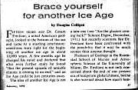
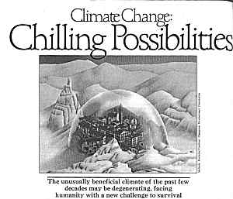
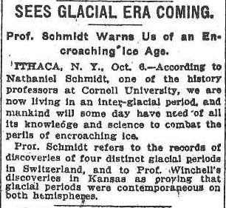
Global Cooling Scare of the 1970s

Slide 10
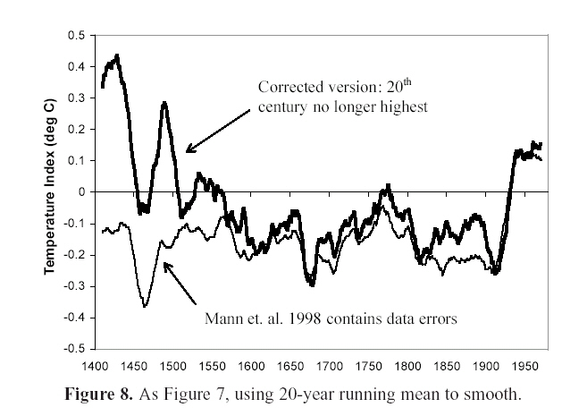

Slide 11
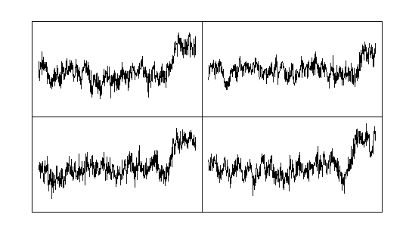
Here are four graphs. One of them is the Hockey Stick Graph, the three others were
produced with the same computer program using completely random data.
Which one is the hockey stick?

Slide 12
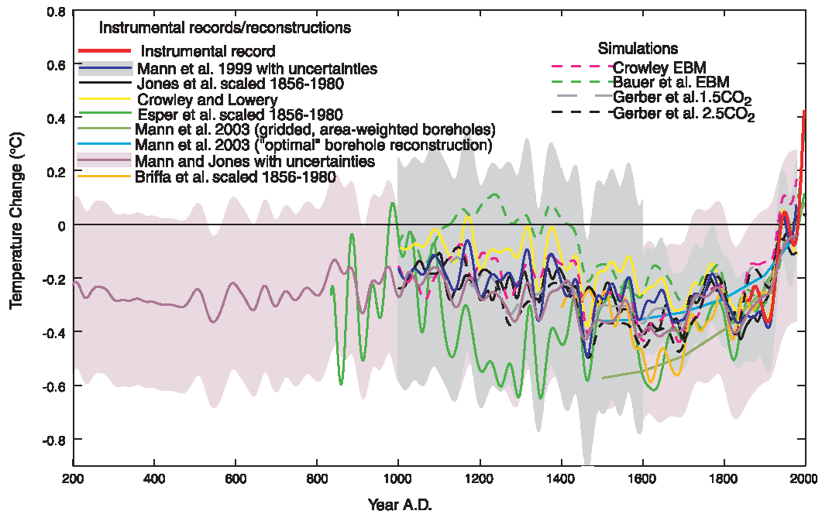
“Spaghetti Graph” from IPCC’s Fourth Assessment Report, 2006

Slide 13
Greenland Ice Cores
Antarctic Ice Cores

Slide 14
Ice Core Record from Peruvian Andes

Slide 15
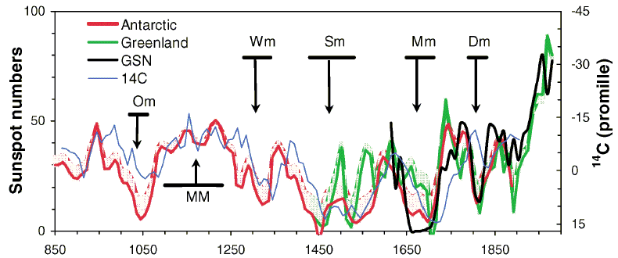
Conclusions
-Global temperature has varied over the last 1000 years
Climate varies naturally over time
-Primary driver of millenial scale climate change is solar variation
-The sun is more active now than any other time in the last
1000 years (Usoskin et al., Phys. Rev. Letters, 2003)
-What is the future of solar activity?

